Slide 1

Introducing {workboots}
Generate prediction intervals from tidymodel workflows
Mark Rieke
2022-07-27
<link to slides>

Slide 2


Slide 3
paint brush with bluetooth

Slide 4
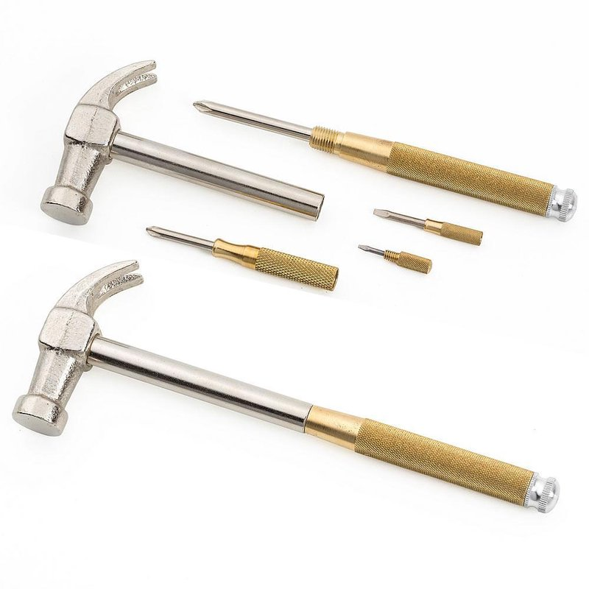

Slide 5
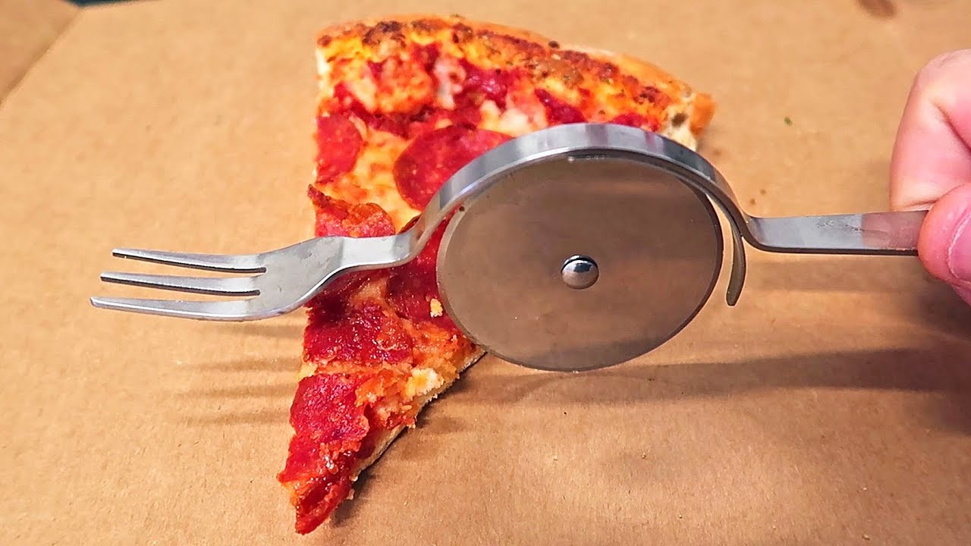

Slide 6
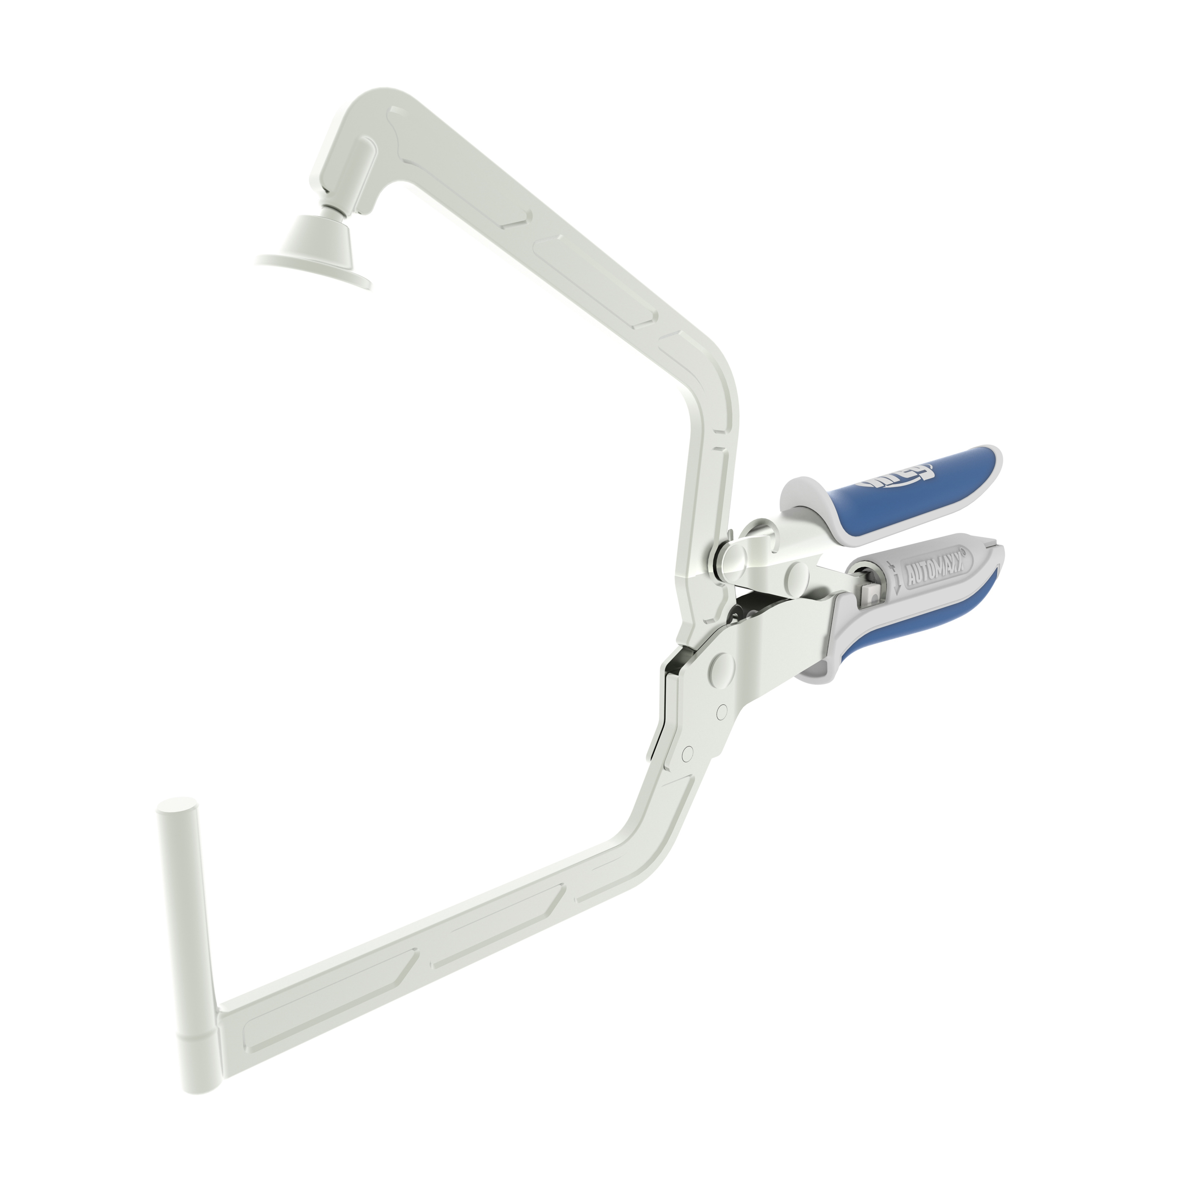
Update with mine later

Slide 7

Update with mine later

Slide 8
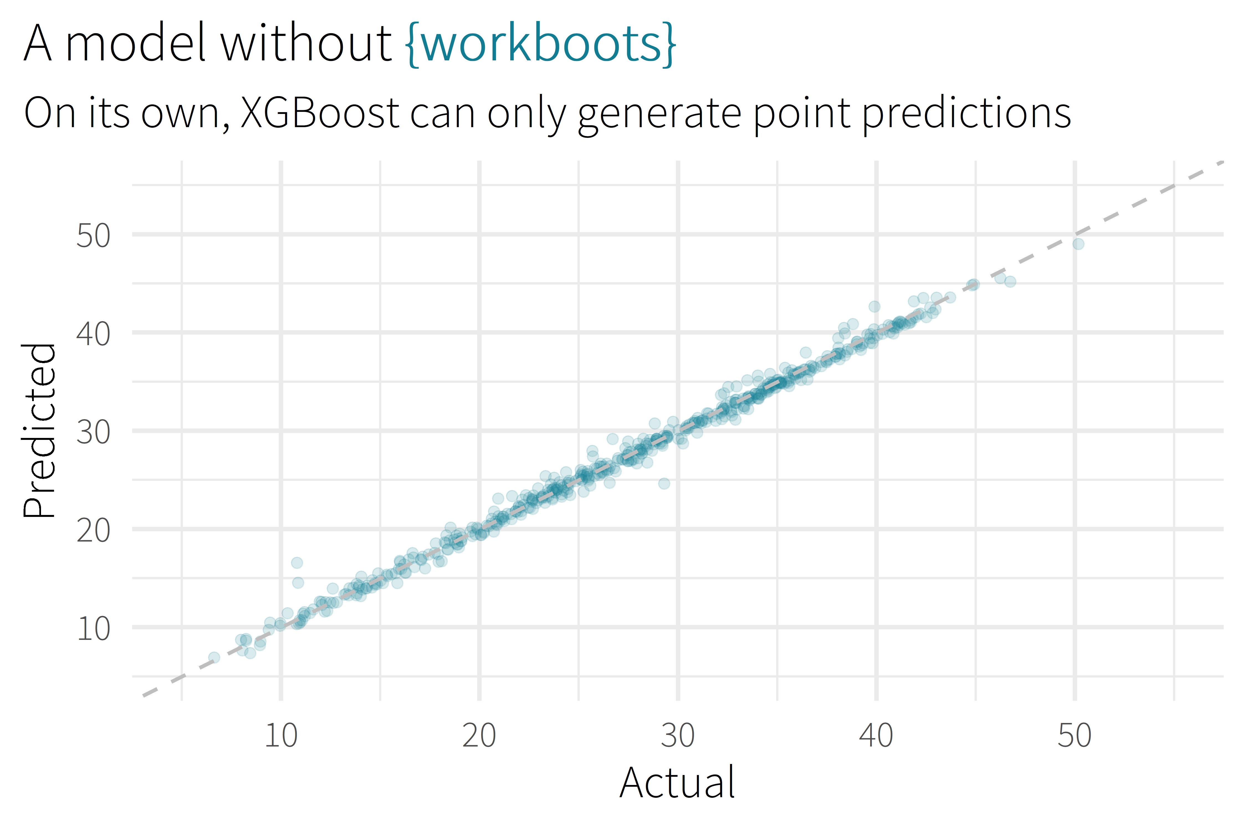

Slide 9
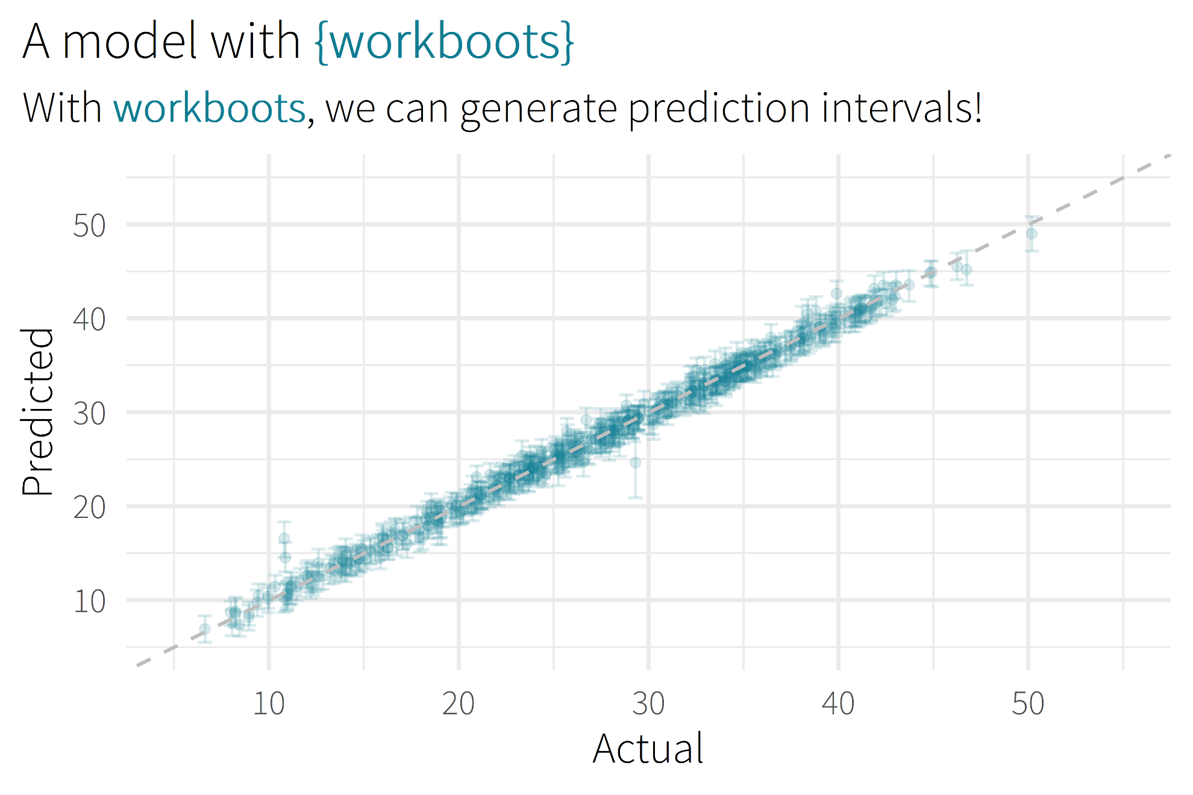

Slide 10

Motivation/Background

Slide 11
Package Overview

Slide 12
“how this works” section
High-level review of methodology
Link to more detail

Slide 13
setting up a workflow
library(tidymodels)

Slide 14
setting up a workflow
library(tidymodels)
# setup our data
data(“penguins”)
penguins <- penguins %>% drop_na()

Slide 15
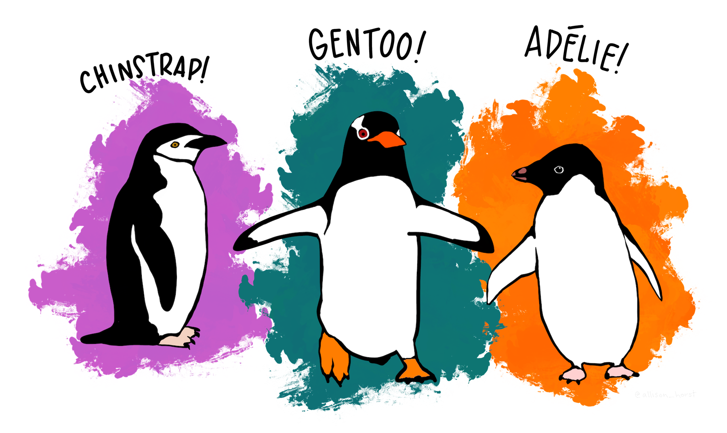
setting up a workflow
library(tidymodels)
# setup our data
data(“penguins”)
penguins <- penguins %>% drop_na()

Slide 16
setting up a workflow
library(tidymodels)
# setup our data
data(“penguins”)
penguins <- penguins %>% drop_na()
set.seed(123)
penguins_split <- initial_split(penguins)
penguins_test <- testing(penguins_split)
penguins_train <- training(penguins_split)

Slide 17
setting up a workflow
# setup a basic preprocessing recipe
penguins_rec <-
recipe(body_mass_g ~ ., data = penguins_train) %>%
step_dummy(all_nominal())

Slide 18
setting up a workflow
# setup a basic preprocessing recipe
penguins_rec <-
recipe(body_mass_g ~ ., data = penguins_train) %>%
step_dummy(all_nominal())
# put together a workflow
penguins_wf <-
workflow() %>%
add_recipe(penguins_rec) %>%
add_model(boost_tree(“regression”))
Notes:
Notes
All tuning parameters finalized (in this case, we’re just using the defaults)
Workflow hasn’t been fit

Slide 19
workbootin’
library(workboots)

Slide 20

workbootin’
library(workboots)

Slide 21
workbootin’
library(workboots)
# generate a bootstrap prediction interval
set.seed(345)
penguins_preds <-
penguins_wf %>%
predict_boots(
n = 2000,
training_data = penguins_train,
new_data = penguins_test,
interval = “prediction”
)

Slide 22
workbootin’
library(workboots)
# generate a bootstrap prediction interval
set.seed(345)
penguins_preds <-
penguins_wf %>%
predict_boots(
n = 2000,
training_data = penguins_train,
new_data = penguins_test,
interval = “prediction”
)
Notes:
Number of bootstrap predictions to make

Slide 23
workbootin’
library(workboots)
# generate a bootstrap prediction interval
set.seed(345)
penguins_preds <-
penguins_wf %>%
predict_boots(
n = 2000,
training_data = penguins_train,
new_data = penguins_test,
interval = “prediction”
)
Notes:
Supply both our training data and new data in one step, since we’ll be fitting and predicting with one function call

Slide 24
workbootin’
library(workboots)
# generate a bootstrap prediction interval
set.seed(345)
penguins_preds <-
penguins_wf %>%
predict_boots(
n = 2000,
training_data = penguins_train,
new_data = penguins_test,
interval = “prediction”
)
Notes:
Supply both our training data and new data in one step, since we’ll be fitting and predicting with one function call

Slide 25
workbootin’
penguins_preds
#> # A tibble: 84 x 5
#> rowid .preds
#> <int> <list>
#> 1 1 <tibble [2,000 x 2]>
#> 2 2 <tibble [2,000 x 2]>
#> 3 3 <tibble [2,000 x 2]>
#> 4 4 <tibble [2,000 x 2]>
#> 5 5 <tibble [2,000 x 2]>
#> # ... With 79 more rows
Notes:
Returns a tibble with 2000 nested predictions for each observation. In this case, each row represents a penguin in the penguins_test dataset.

Slide 26
workbootin’
penguins_preds %>%
summarise_predictions() %>% select(-.preds)
#> # A tibble: 84 x 5
#> rowid .pred .pred_lower .pred_upper
#> <int> <dbl> <dbl> <dbl>
#> 1 1 3465. 2913. 3994.
#> 2 2 3535. 2982. 4100.
#> 3 3 3604. 3050. 4187.
#> 4 4 4157. 3477. 4764.
#> 5 5 3868. 3305. 4372.
#> # ... With 79 more rows
Notes:
Can pass this to summarise_predictions(), which appends each prediction with the median, upper and lower interval bounds.

Slide 27
workbootin’
library(workboots)
# generate a bootstrap prediction interval
set.seed(345)
penguins_preds <-
penguins_wf %>%
predict_boots(
n = 2000,
training_data = penguins_train,
new_data = penguins_test,
interval = “prediction”
)

Slide 28
workbootin’
library(workboots)
# generate a bootstrap prediction interval
set.seed(345)
penguins_preds <-
penguins_wf %>%
predict_boots(
n = 2000,
training_data = penguins_train,
new_data = penguins_test,
interval = “prediction”
)
Notes:
By default, predict_boots() will generate a prediction interval

Slide 29
workbootin’
library(workboots)
# generate a bootstrap prediction interval
set.seed(345)
penguins_preds <-
penguins_wf %>%
predict_boots(
n = 2000,
training_data = penguins_train,
new_data = penguins_test,
interval = “confidence”
)
Notes:
But we can also generate

Slide 30
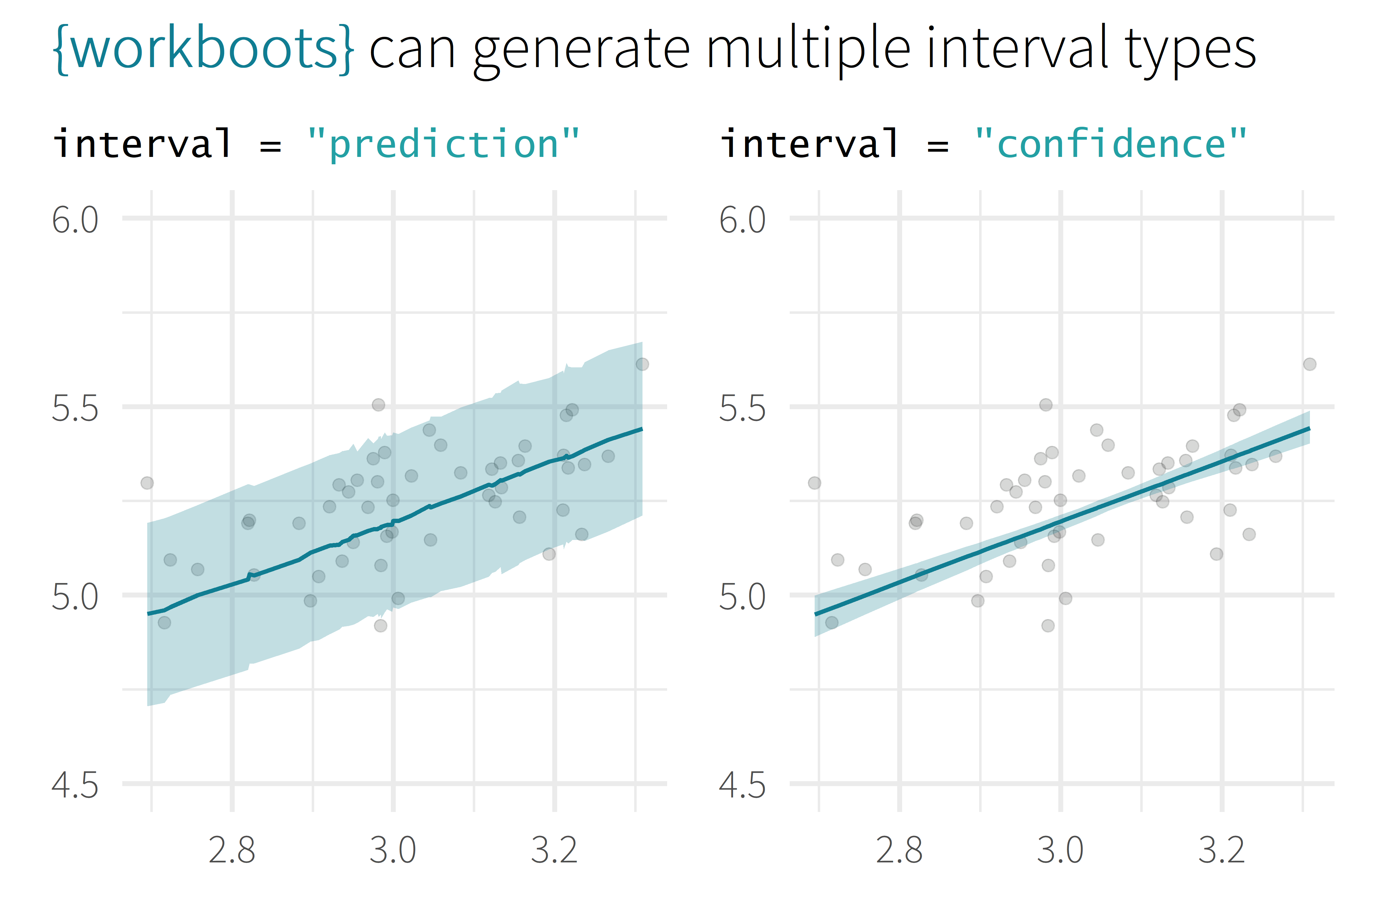
log10(Sale_Price)
log10(First_Flr_SF)

Slide 31
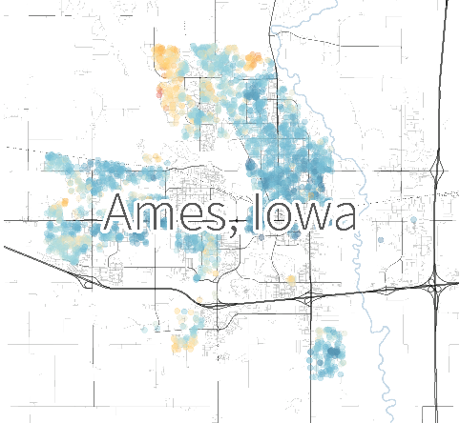
log10(Sale_Price)
log10(First_Flr_SF)

Slide 32
workbootin’
# generate a bootstrap variable importances
set.seed(345)
penguins_vi <-
penguins_wf %>%
vi_boots(
n = 2000,
training_data = penguins_train
)

Slide 33
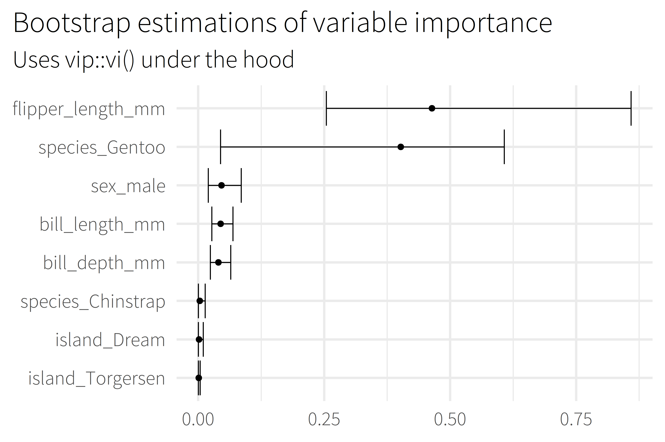
Notes:
Uses the vip package under the hood to estimate model-specific importance.
Some model types aren’t supported by vip

Slide 34
Backup

Slide 35
overview
Selling Point
About me
Motivation / Background
Package overview
Cost of doing business
(1 min)
(2 min)
(5 min)
(5 min)
(5 min)

Slide 36








about me
BSME, University of Tulsa
Sr. CX Analyst, MHHS
@markjrieke

Slide 37
“I use R and tidymodels to provide actionable insight from patient survey data.”

Slide 38
plot/plot/plot

Slide 39
plot/plot/plot
context/context/context

Slide 40

5.0 (19)
4.6 (2,280)

Slide 41
What is the range of possible outcomes?
How important is each variable in the model?

Slide 42

lm()
me
XGBoost

Slide 43
Prediction Intervals

Slide 44
Prediction Intervals
Powerful Models

Slide 45
Prediction Intervals
{workboots}
Powerful Models

Slide 46
Prediction Intervals
{workboots}
Powerful Models
via bootstrap resampling

